Slide 1


PHISHING
AWARENESS
RECOGNIZE AND AVOID PHISHING ATTACKS

Slide 2
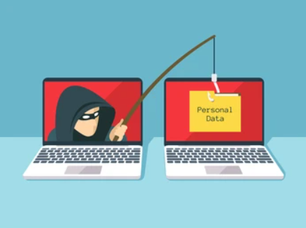


INTRODUCTION TO PHISHING
Phishing is a cyberattack in which attackers pose as legitimate entities to trick users into providing sensitive information (passwords, credit card numbers, etc.).
Examples: Fake emails, fraudulent websites, social media messages, SMS, etc.

Slide 3

01
02
03
04
EMAIL PHISHING
SPEAR PHISHING
WHALING
CLONE PHISHING
Fake emails pretending to be from banks, services, or colleagues.
Characteristics: Misspelled domains, urgent requests, suspicious links.
Targeted attacks aimed at specific individuals or organizations.
Usually involves research to make the email appear more convincing.
Phishing targeted at high-level executives to access sensitive information.
Attacker copies a legitimate email and changes a few elements (like links or attachments) to redirect victims to malicious sites.

Slide 4
01
02
05
SMISHING AND VISHING
Smishing: Phishing via SMS
Vishing: Phishing via voice calls or voicemail

Slide 5

ANATOMY OF A PHISHING EMAIL
How to Recognize a Phishing Email
3
Sender address:
Check if the email address is spoofed or suspicious.
Urgency or fear tactics: Warnings about account suspensions or urgent actions
Generic greetings: Phrases like "Dear customer" instead of your actual name.
Suspicious links or attachments
Links leading to fake websites or dangerous attachments.

Slide 6
IDENTIFYING MALICIOUS WEBSITES
How to Spot a Phishing Website
Lack of HTTPS
Secure websites use HTTPS (check for the padlock symbol).
Poor design and grammar errors:
Many phishing websites have poor grammar or formatting issues.
Requests for personal information:
Legitimate companies never ask for sensitive data through websites or emails.
URL discrepancies: Misspelled URLs or domains similar to legitimate ones.

Slide 7





Impersonation: Attackers pretend to be someone you trust.
Pretexting: The attacker creates a scenario to steal information
Baiting: Offering something (e.g., free downloads) to lure the victim into sharing information.
Tailgating: Gaining physical access to restricted areas by following authorized individuals.
Phishing: where attackers send emails or messages pretending to be a legitimate entity
SOCIAL ENGINEERING TACTICS
Understanding Social Engineering

Slide 8
WHAT TO DO IF YOU RECEIVE A PHISHING EMAIL
Steps to Take When You Suspect Phishing
Do not click any links or open attachments.
Verify the sender by contacting the organization directly
Report the email to your organization's IT/security team.
Mark the email as spam or phishing in your email client.

Slide 9
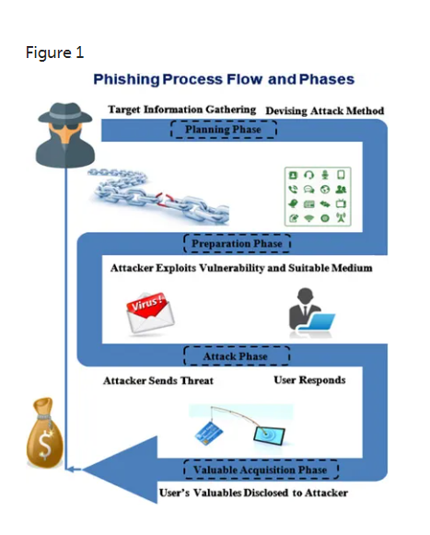
REAL-LIFE EXAMPLES
CASE STUDIES OF PHISHING ATTACKS
The 2016 DNC (Democratic National Committee) Phishing Attack:
In 2016, during the U.S. Presidential Election, the Democratic National Committee (DNC) was targeted by a significant phishing attack that led to a major data breach. This attack exposed sensitive information and influenced the political landscape.
Consequences of the Attack:
Damage to Reputation
Political Fallout
Security Reforms

Slide 10
MULTI-FACTOR AUTHENTICATION (MFA): .
ANTI-PHISHING SOFTWARE
SECURITY AWARENESS TRAINING:
EMAIL FILTERING TOOLS
Install security solutions that detect phishing attempts.
Automatically detect and filter phishing emails.
Adds an extra layer of security to your accounts
Regular training to recognize phishing attacks.
TOOLS TO PROTECT AGAINST PHISHING
Protecting Yourself from Phishing

Slide 11



CONCLUSION
Always verify before you trust.
Phishing is constantly evolving, so it’s essential to stay informed.
Report any suspicious activity to help protect yourself and your organization.

